Slide 1


Big Companies and COVID-19
MaNaKeAn January 16, 2021

Slide 2
Objective
In general, the stock market spent the last four years on an upward trajectory.
However, COVID-19 disrupted the economy in ways no one predicted.
Our plan: Evaluate two random stocks in five random industries to see if and how they were impacted.

Slide 3




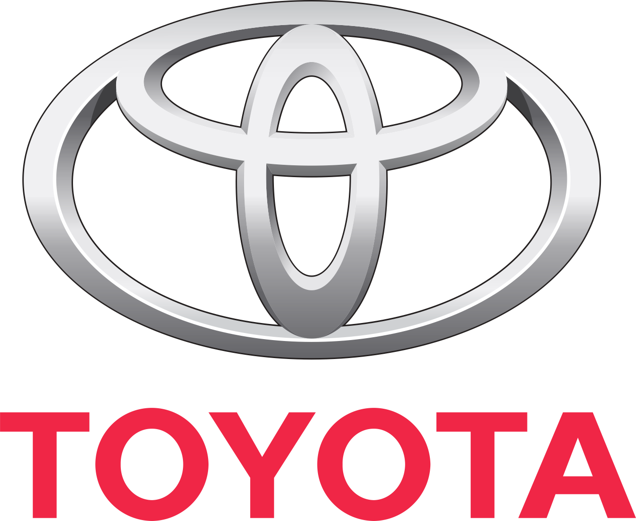





LOGISTICS
RETAIL
AUTO INDUSTRY
AIRLINE
SOCIAL MEDIA
10
random companies in
5
random markets

Slide 4
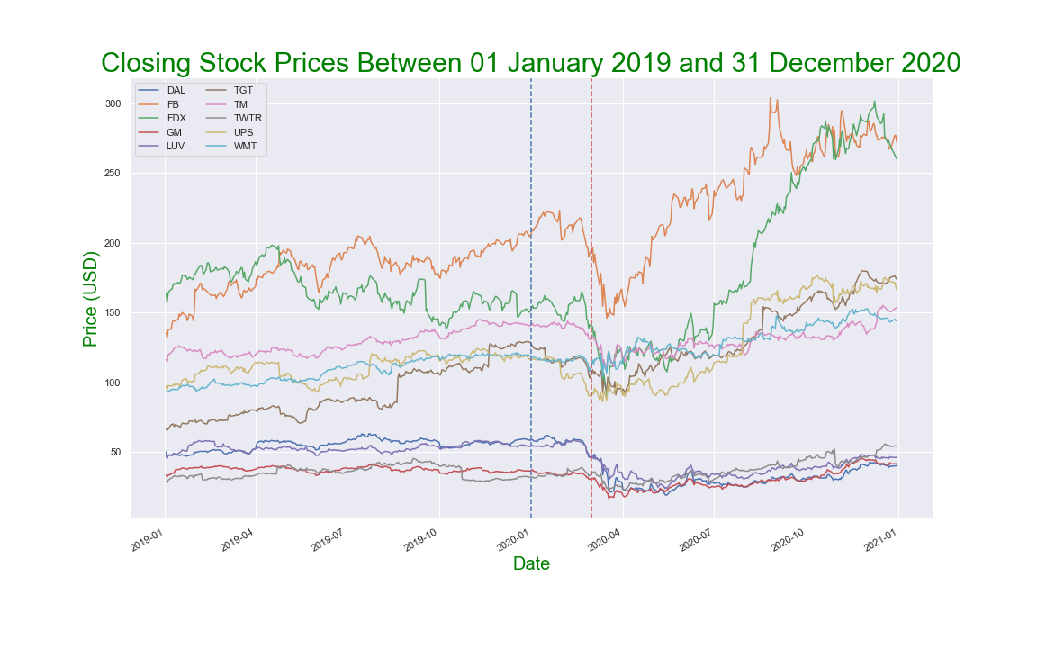
How did each company fare?

Slide 5
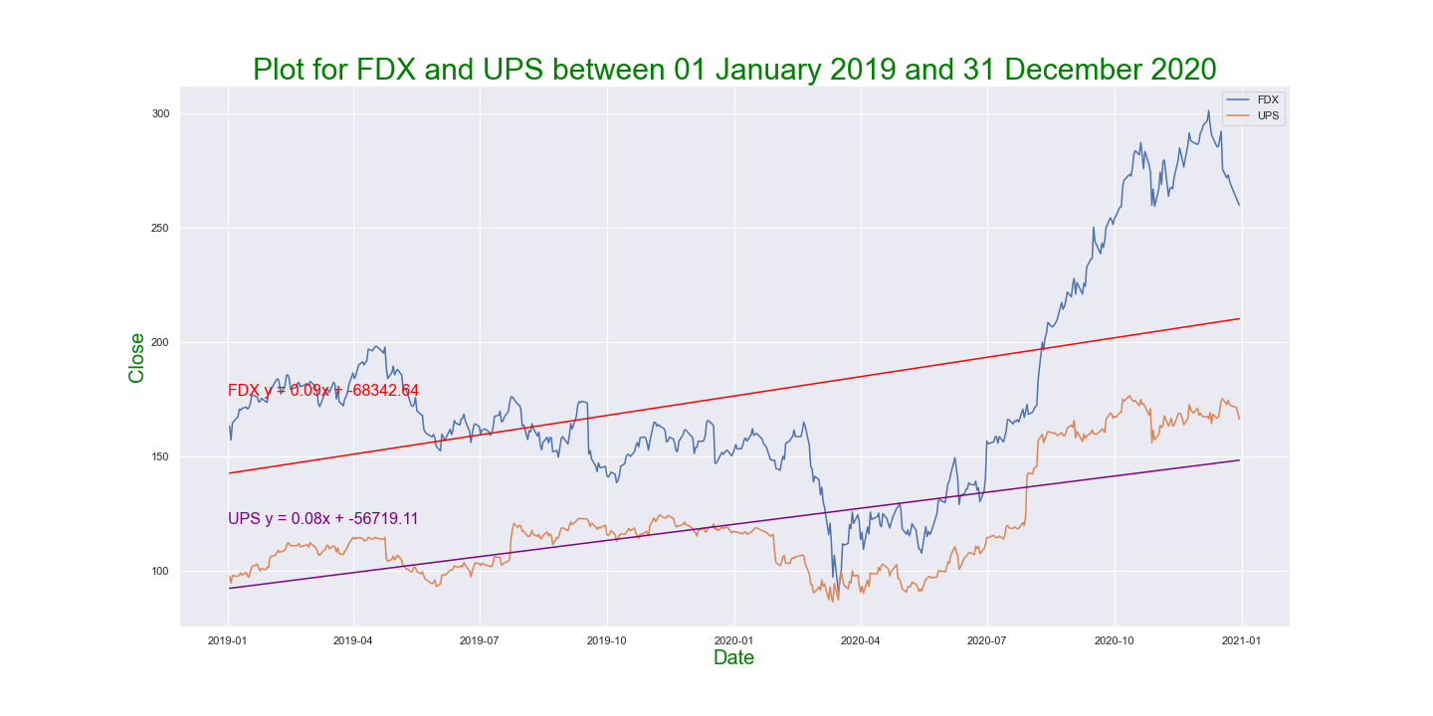
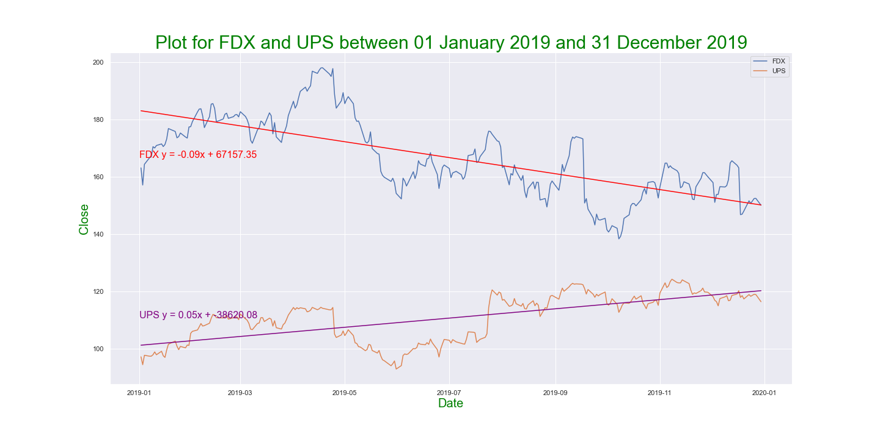
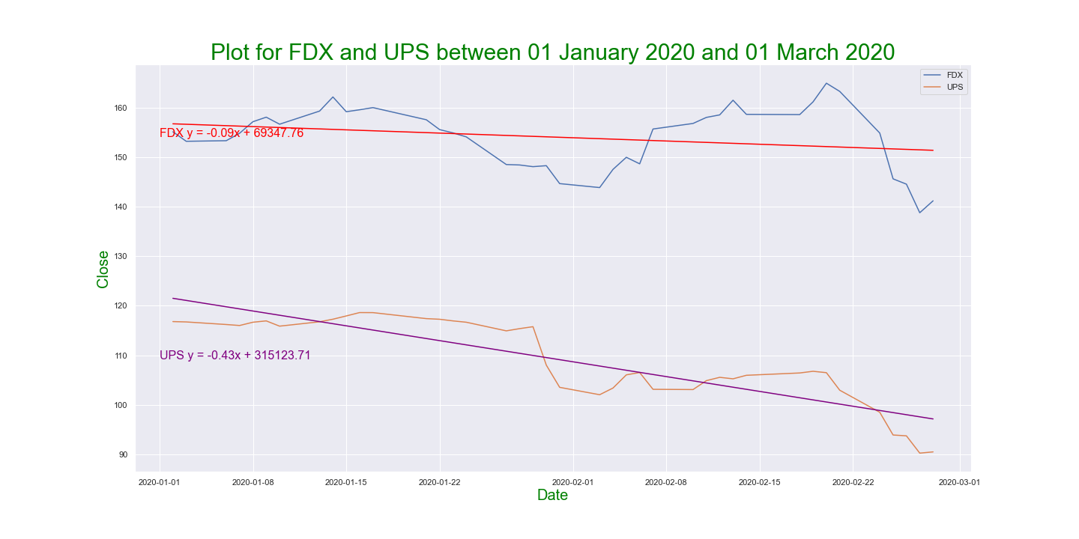
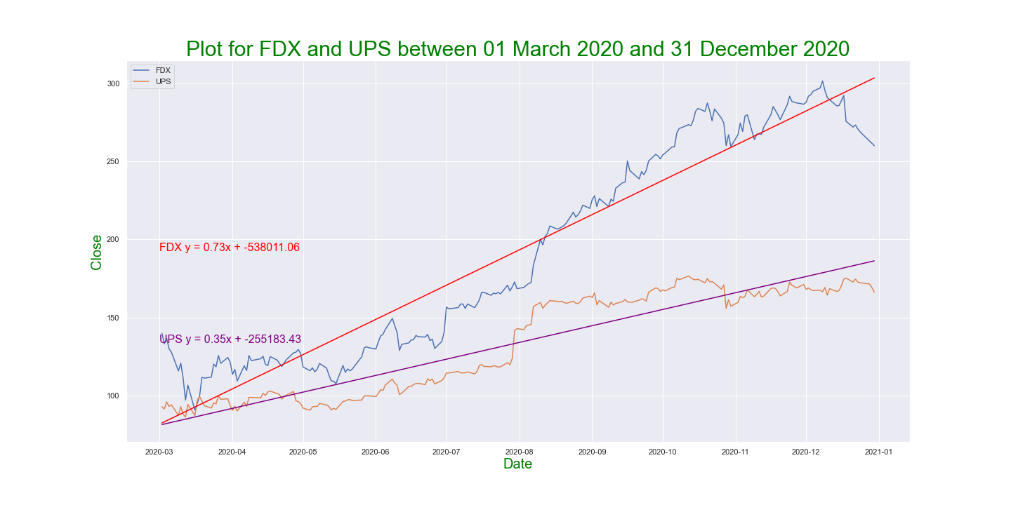
Closing Prices | 2019 and 2020 Regression Review | Logistics

Slide 6
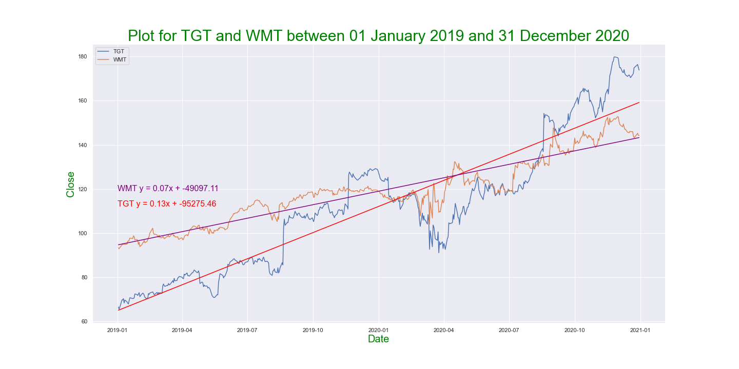
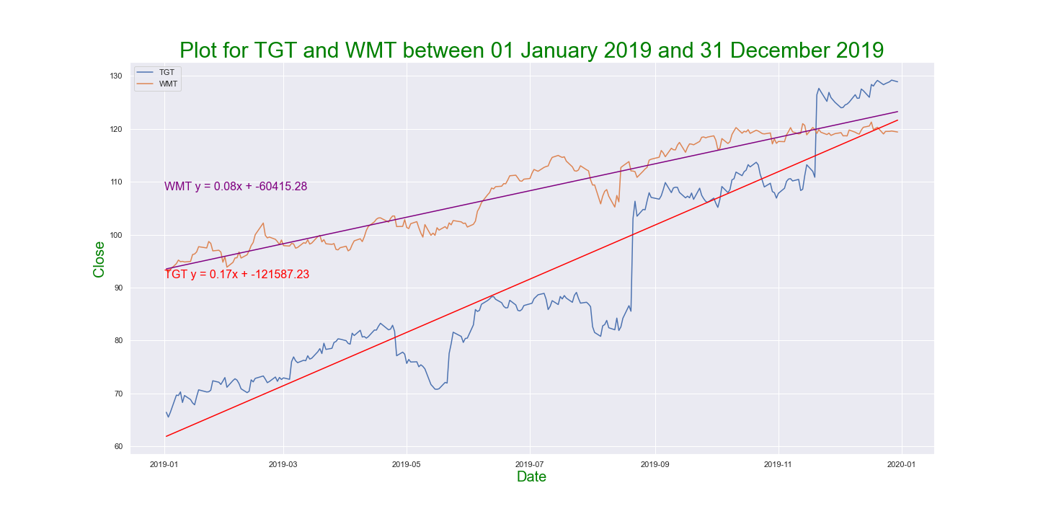
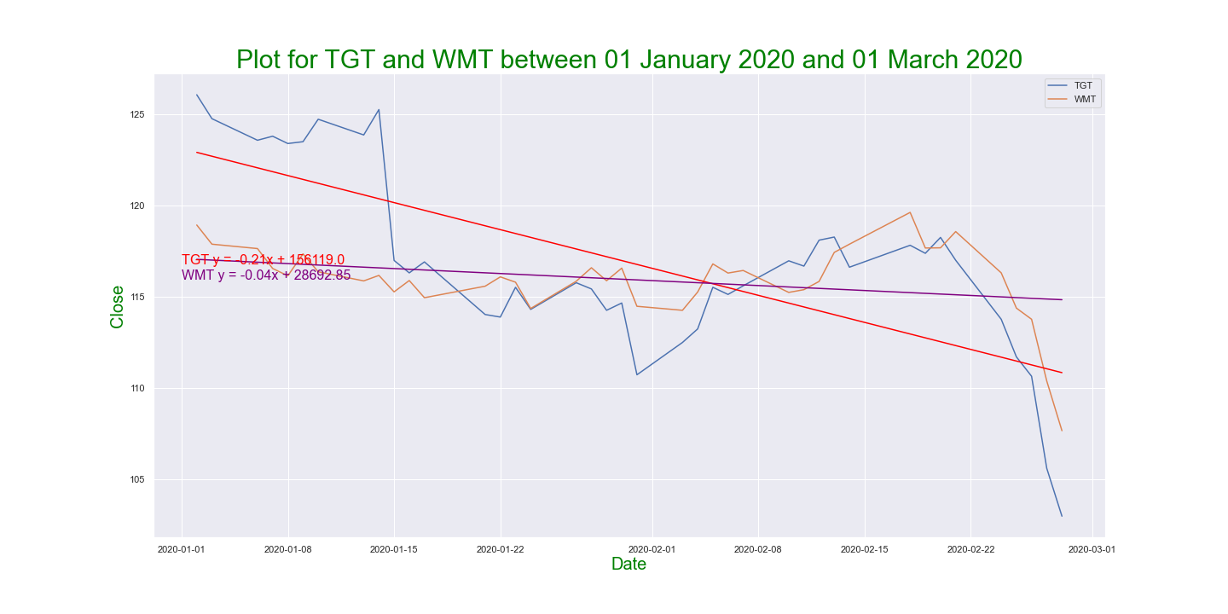
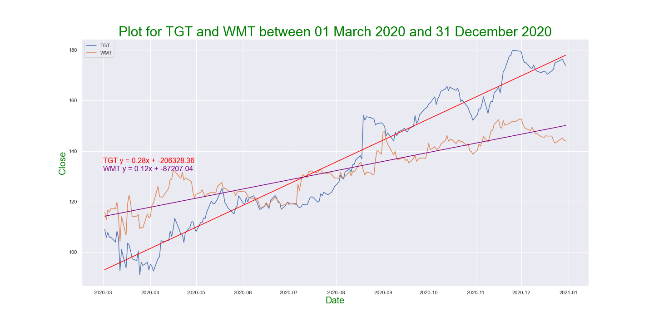
Closing Prices | 2019 and 2020 Regression Review | Retail

Slide 7
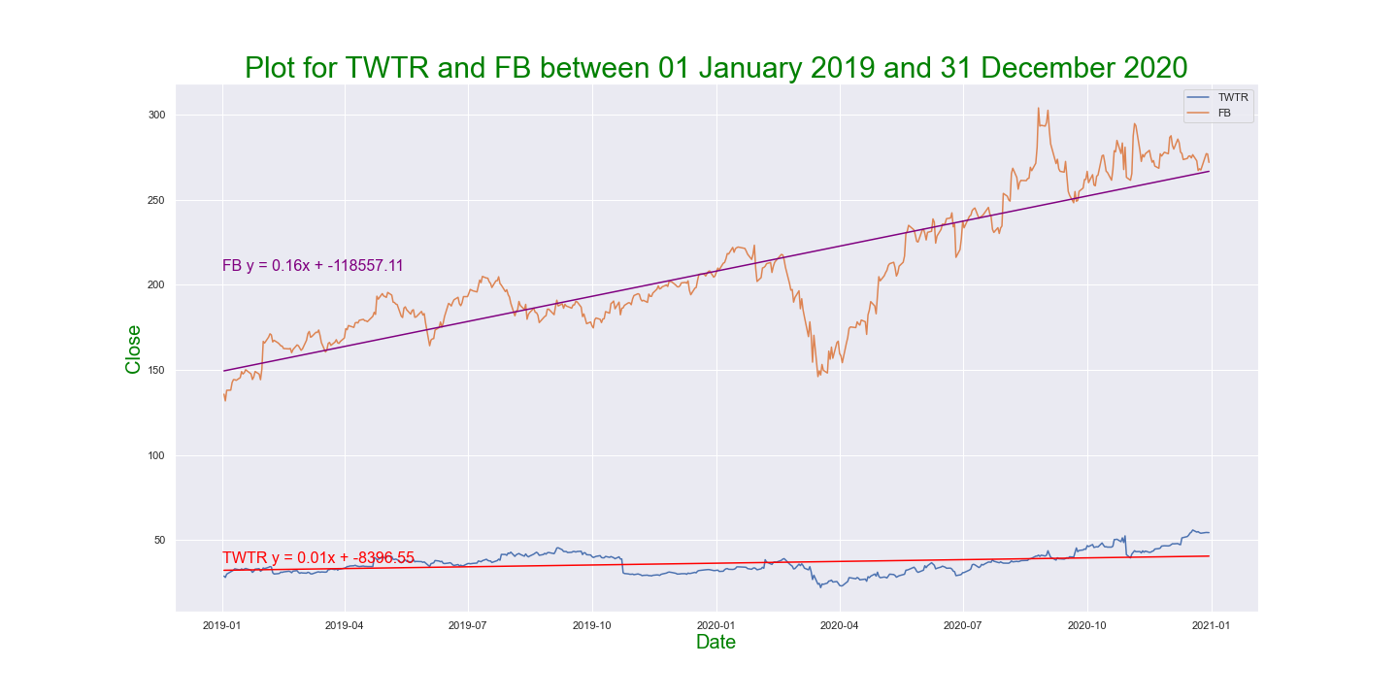
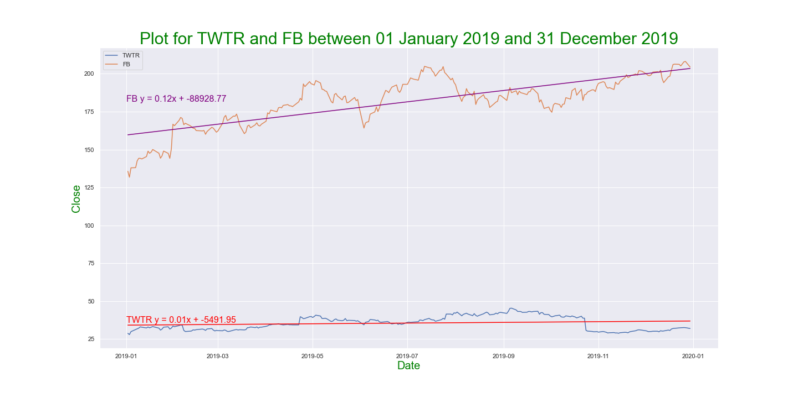
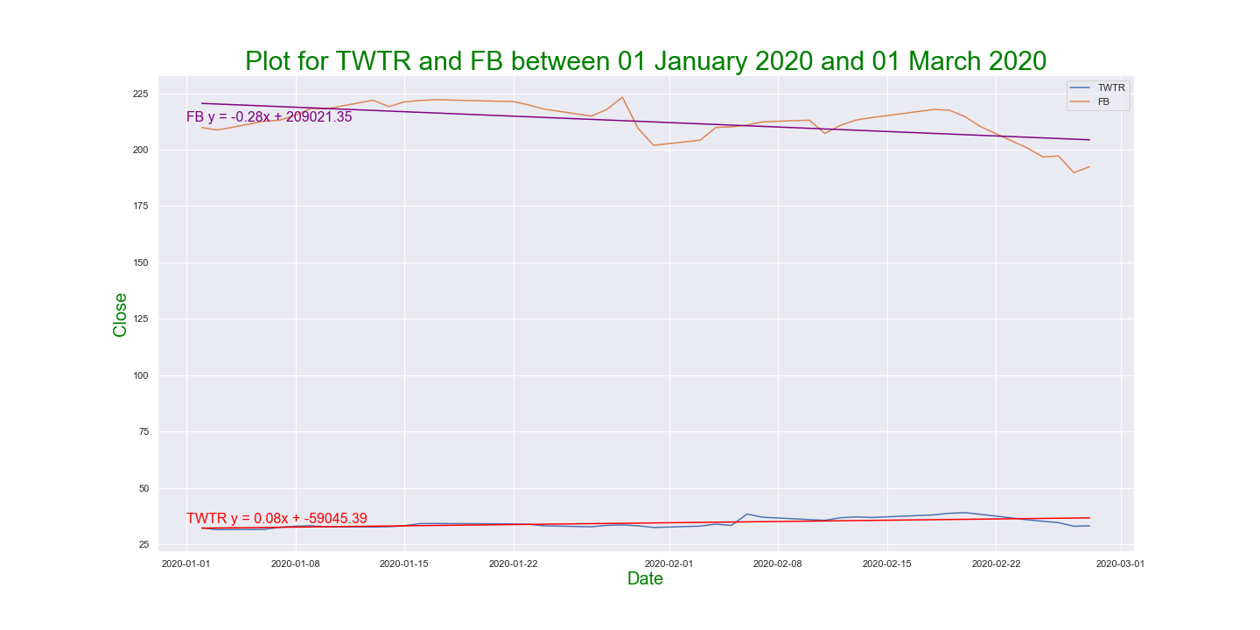
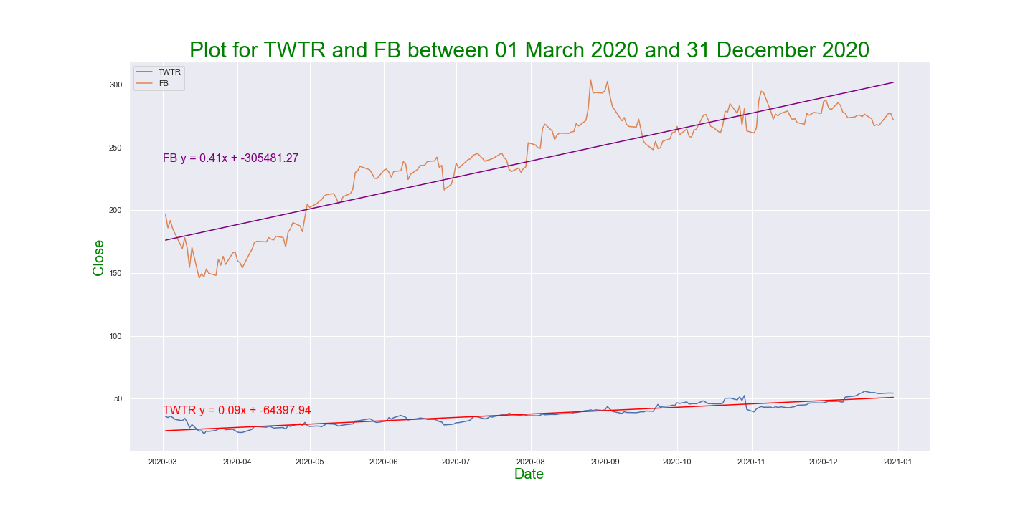
Closing Prices | 2019 and 2020 Regression Review | Social Media

Slide 8
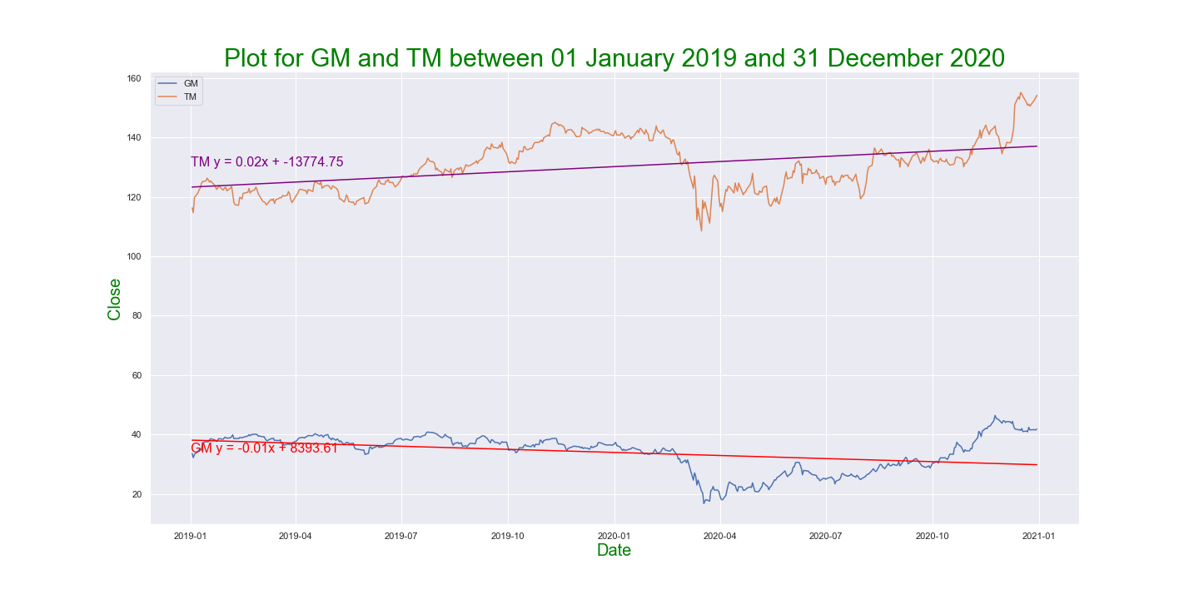
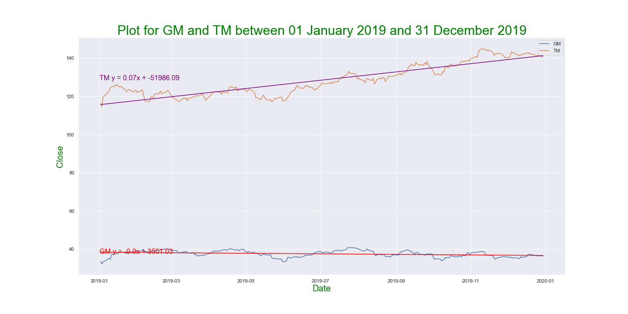
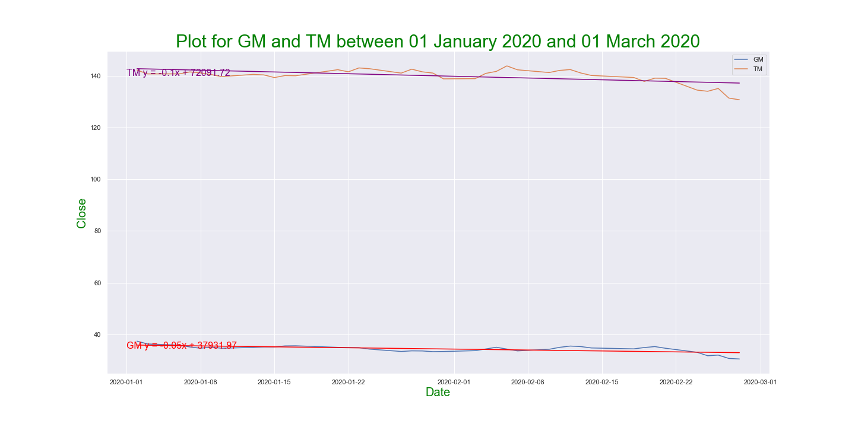
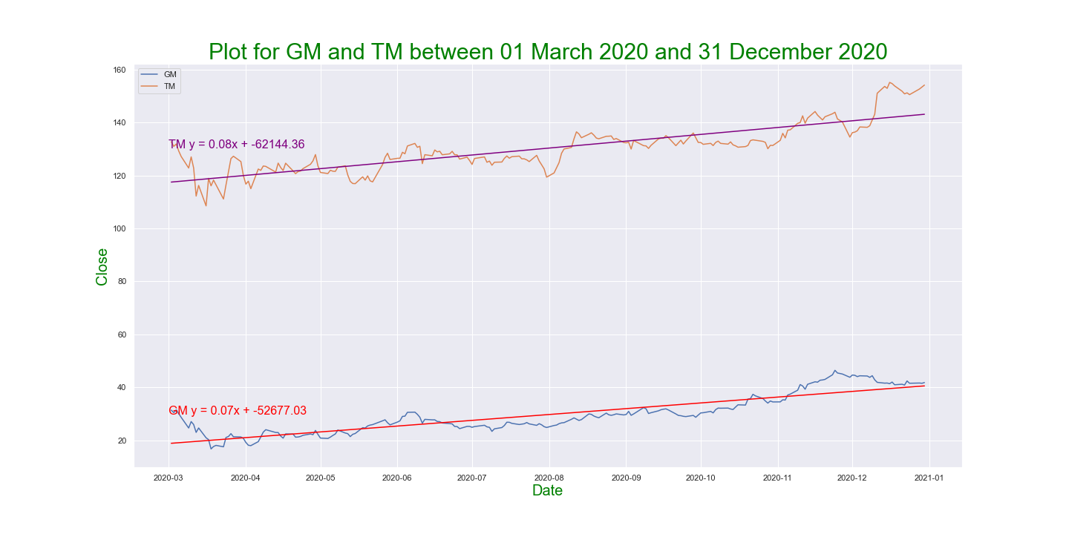
Closing Prices | 2019 and 2020 Regression Review | Auto Industry

Slide 9
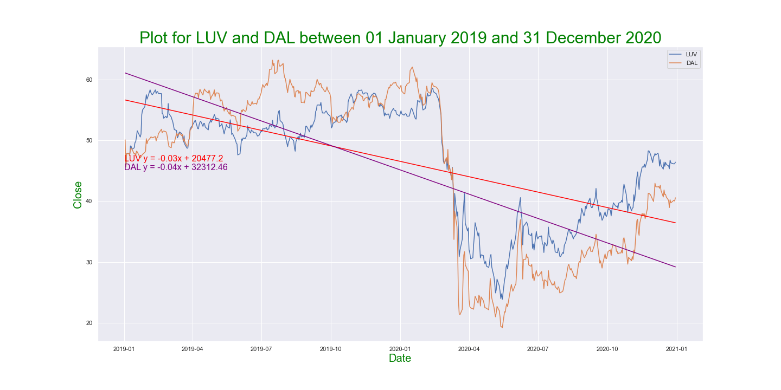
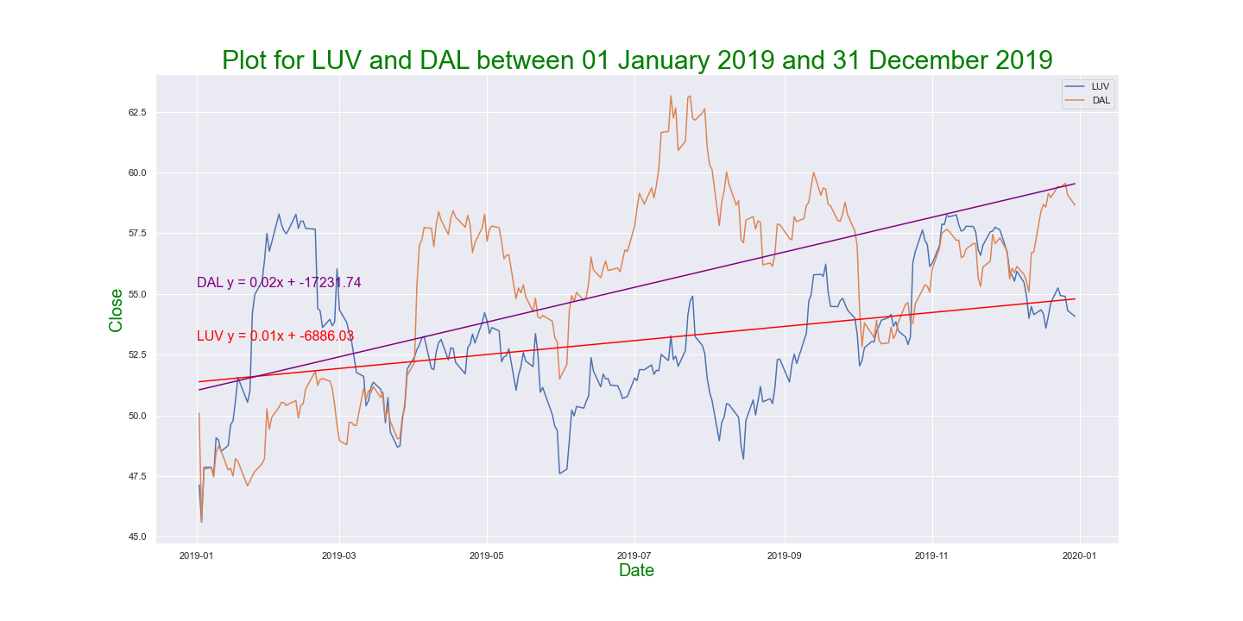
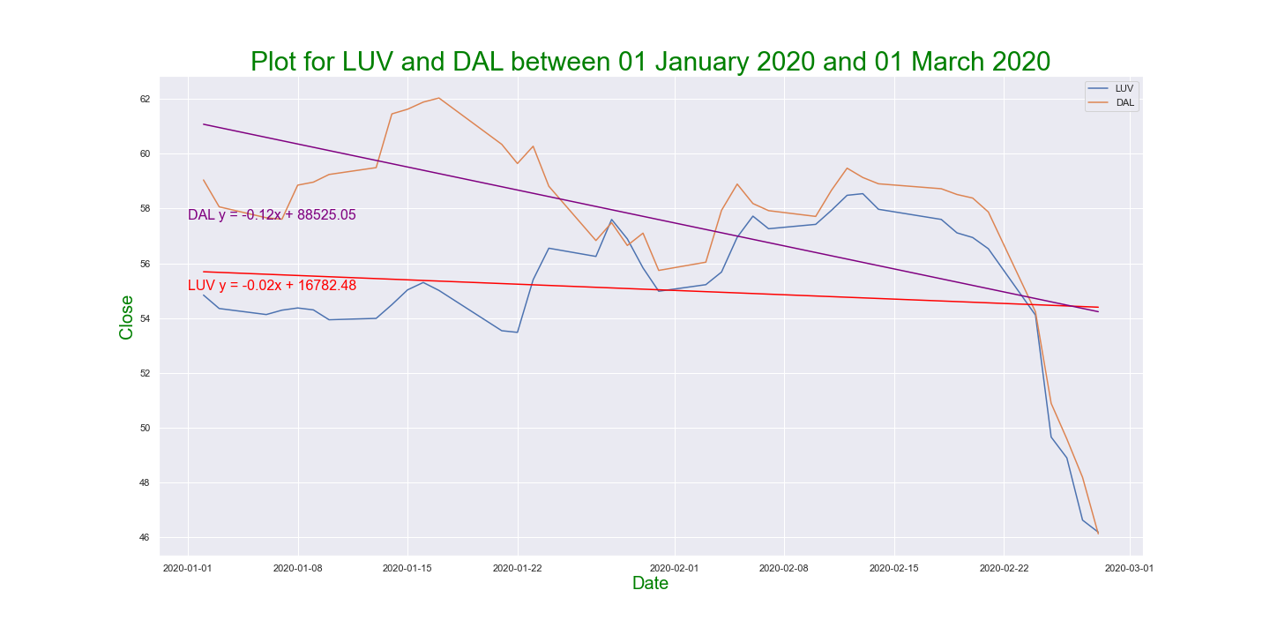
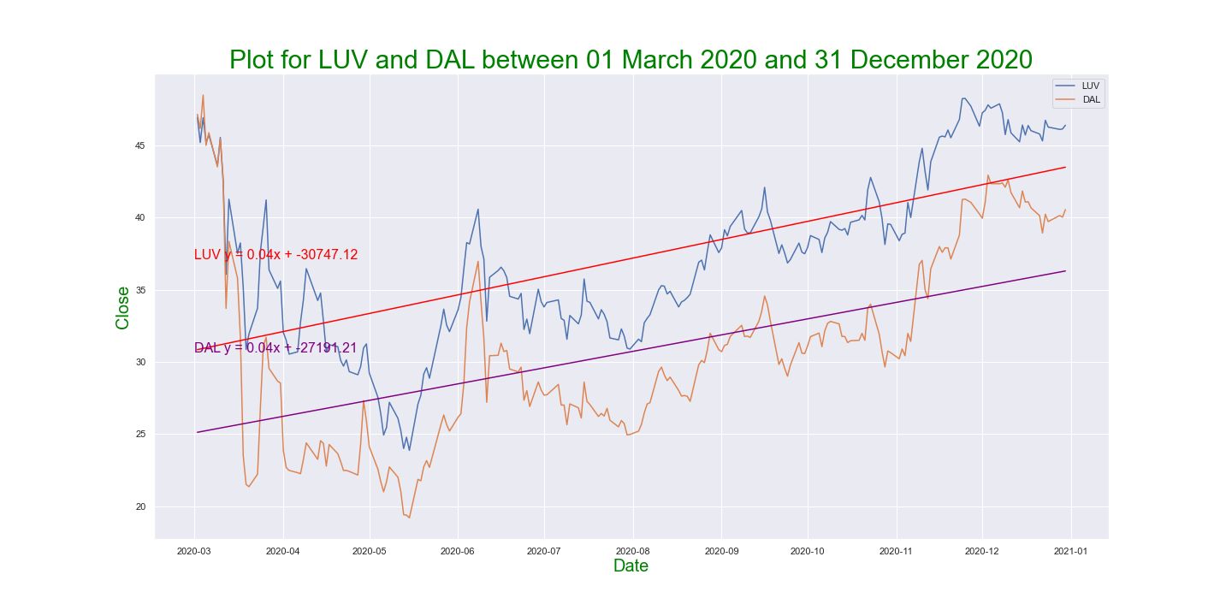
Closing Prices | 2019 and 2020 Regression Review | Airlines

Slide 10
Closing Prices | 2019 through 2020 Regression Review

Slide 11
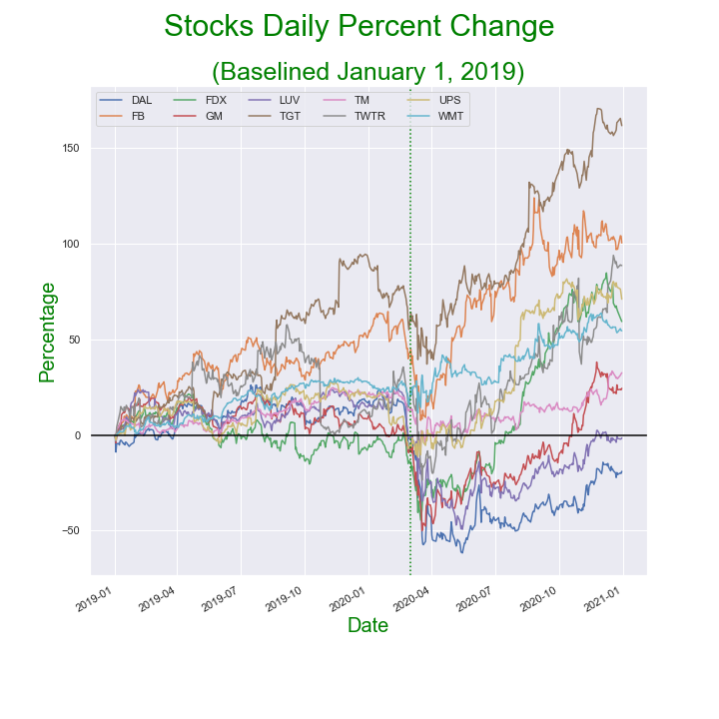
Daily Percent Change based on January 1, 2019 stock price

Slide 12
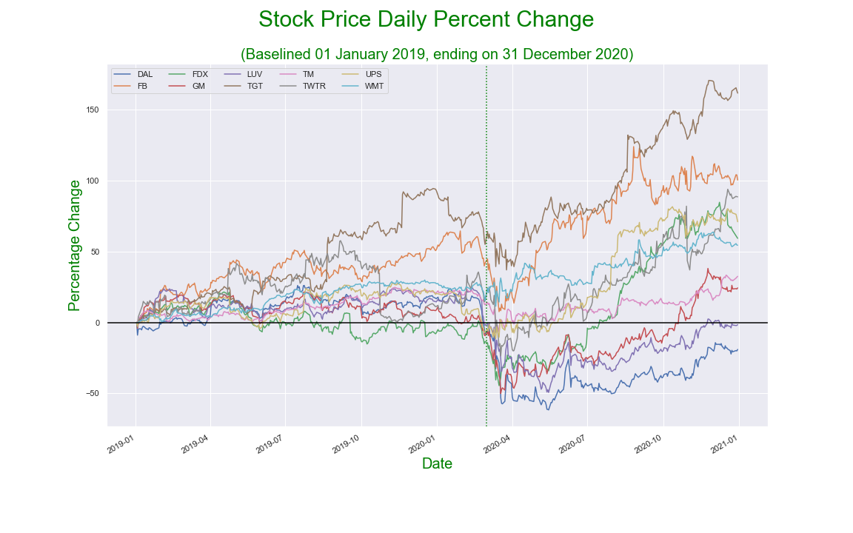
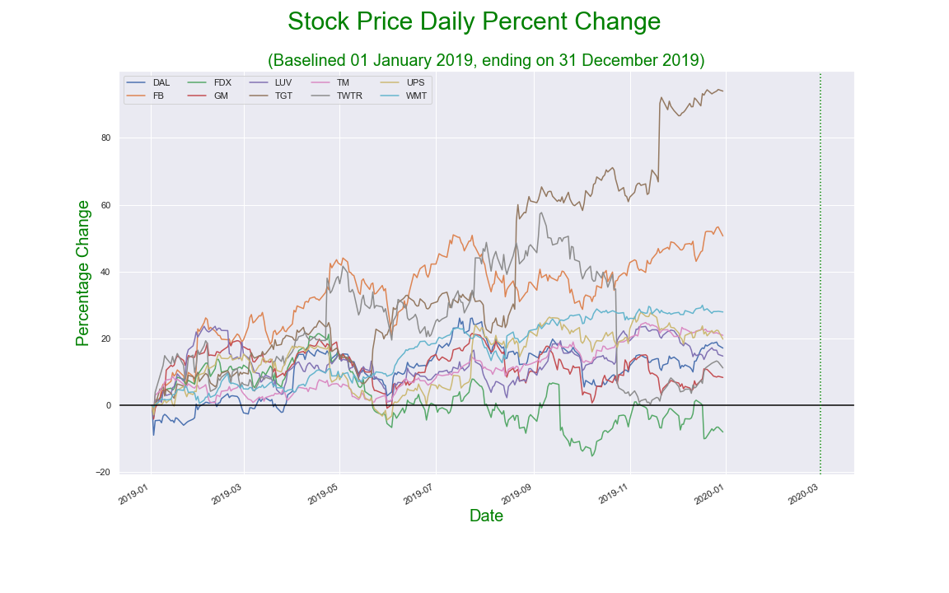
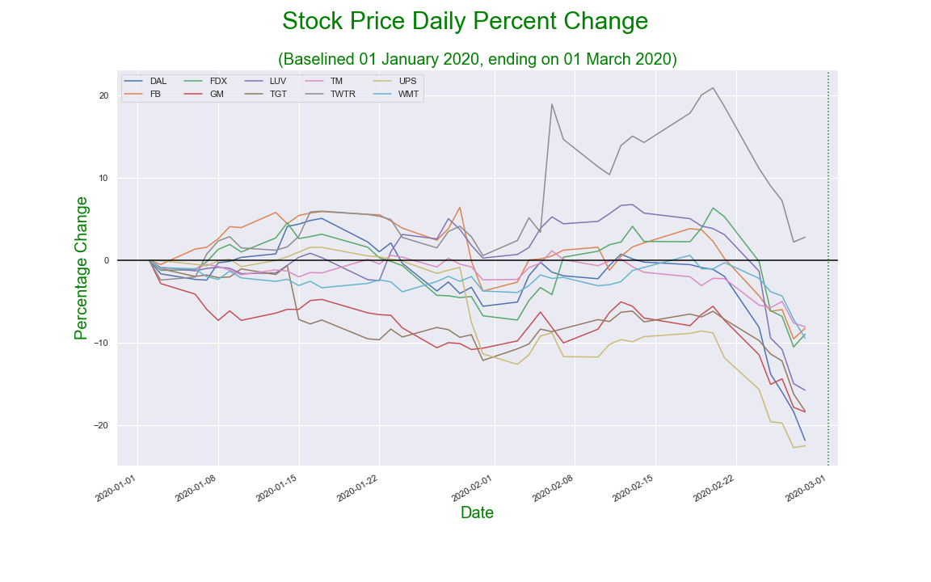
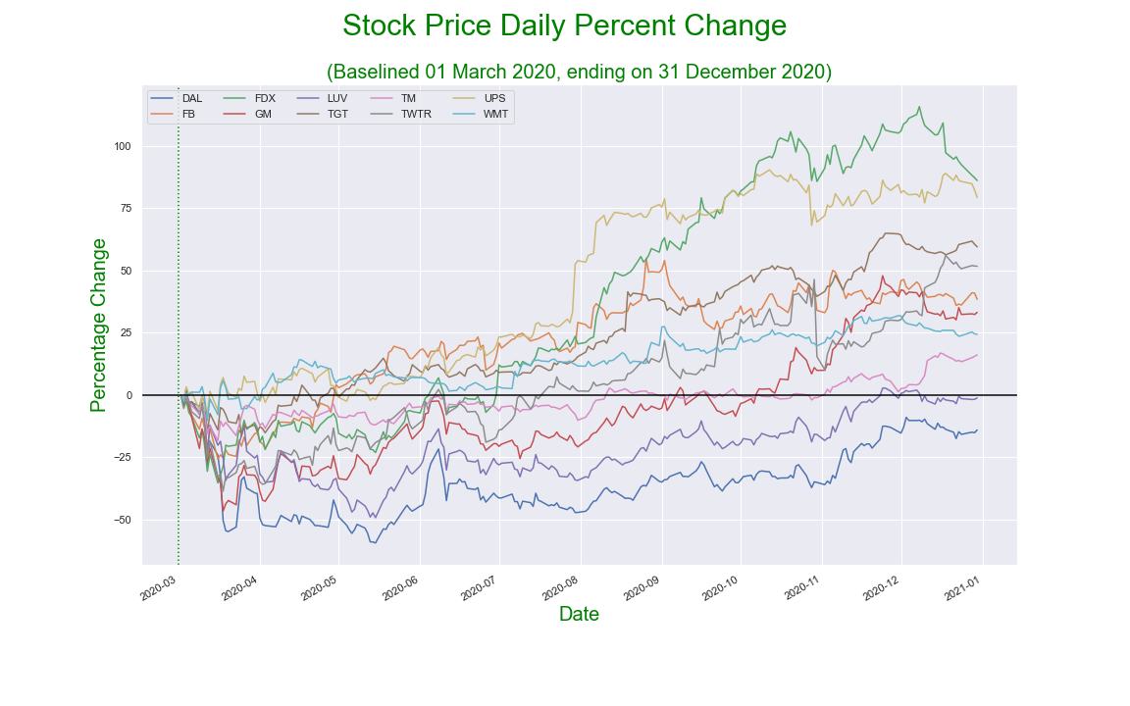
Percent Change during different pre- and post COVID time period

Slide 13
Data source
YFINANCE library | Downloaded historical stock data for each company Daily closing prices Sliced data into the required time periods

Slide 14
Analysis process
Determined time periods of interest
January 1, 2019 (selected baseline) through December 31, 2020
January 1 until March 1, 2020: pre-COVID
Pandemic declared: March 11, 2020
Applied calculations
Regressions over several time periods during 2019 and 2020
Percentage daily change
Created charts showing the results

Slide 15
Implications

Slide 16
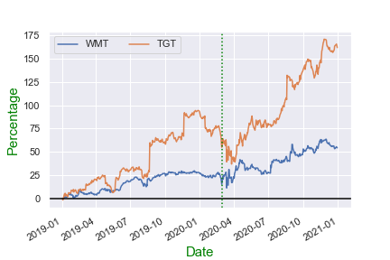
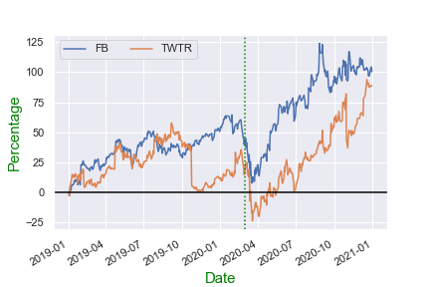
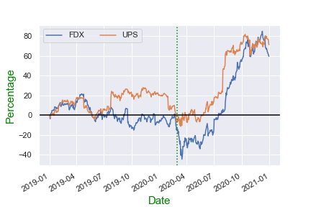
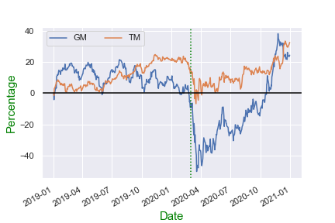
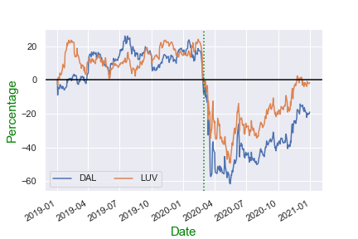
LATE 2020 BIG WINNERS
LATE 2020 STILL RECOVERING

Slide 17
Final Conclusions
The stock market in 2019 was mostly doing well. The S&P 500 rose by 29% and NASDAQ by 35% which are great indicators of how the market was doing. The DOW ended the year with a 22% gain, making it the best year since 2017.
For the year 2020, the stock market continued to rise, until March 16th (which is referred to as Black Monday II). The stock market crashed due to the Covid-19 pandemic. It was expected because of the uncertainty of the pandemic. A lot of investors panicked because the world didn’t know what this pandemic could bring. Black Monday II caused a drop of 12% in global markets.
As our understanding of the Coronavirus improved, the stock market began to recover quickly. Most industries recovered and hit all time highs, except the airlines industry, which is still suffering to this day.

